Slide 1

Design Patterns
Some Patterns Overview

Slide 2
Patterns by Type
Creational
Creational patterns are ones that create objects for you, rather than having you instantiate objects directly. This gives your program more flexibility in deciding which objects need to be created for a given case
Structural
These concern class and object composition. They use inheritance to compose interfaces and define ways to compose objects to obtain new functionality.
Behavioral
Most of these design patterns are specifically concerned with communication between objects.

Slide 3
Creational
Abstract factory pattern groups object factories that have a common theme.
Builder pattern constructs complex objects by separating construction and representation.
Factory method pattern creates objects without specifying the exact class to create.
Prototype pattern creates objects by cloning an existing object.
Singleton pattern restricts object creation for a class to only one instance

Slide 4
Structural
Adapter allows classes with incompatible interfaces to work together by wrapping its own interface around that of an already existing class.
Bridge decouples an abstraction from its implementation so that the two can vary independently.
Composite composes zero-or-more similar objects so that they can be manipulated as one object.
Decorator dynamically adds/overrides behaviour in an existing method of an object.

Slide 5
Structural
Facade provides a simplified interface to a large body of code.
Flyweight reduces the cost of creating and manipulating a large number of similar objects.
Proxy provides a placeholder for another object to control access, reduce cost, and reduce complexity.

Slide 6
Behavioral
Chain of responsibility delegates commands to a chain of processing objects.
Command creates objects which encapsulate actions and parameters.
Interpreter implements a specialized language.
Iterator accesses the elements of an object sequentially without exposing its underlying representation.
Mediator allows loose coupling between classes by being the only class that has detailed knowledge of their methods.
Memento provides the ability to restore an object to its previous state (undo).

Slide 7
Behavioral
Observer is a publish/subscribe pattern which allows a number of observer objects to see an event.
State allows an object to alter its behavior when its internal state changes.
Strategy allows one of a family of algorithms to be selected on-the-fly at runtime.
Template method defines the skeleton of an algorithm as an abstract class, allowing its subclasses to provide concrete behavior.
Visitor separates an algorithm from an object structure by moving the hierarchy of methods into one object.

Slide 8
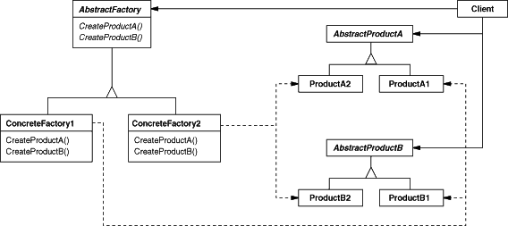
Abstract Factory
Abstract Factory pattern provides an interface for creating families of related or dependent objects without specifying their concrete classes.

Slide 9
Abstract Factory
The Abstract Factory design pattern solves problems like:
How can an application be independent of how its objects are created?
How can a class be independent of how the objects it requires are created?
How can families of related or dependent objects be created?
The Abstract Factory design pattern describes how to solve such problems:
Encapsulate object creation in a separate (factory) object. That is, define an interface (AbstractFactory) for creating objects, and implement the interface.
A class delegates object creation to a factory object instead of creating objects directly.

Slide 10
Abstract Factory
Can you think out a scenario to use abstract factory pattern in your previous coding task?

Slide 11
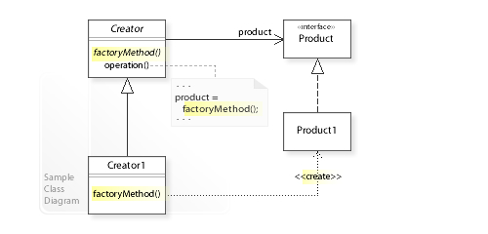
Factory Method
Define an interface for creating an object, but let subclasses decide which class to instantiate. The Factory method lets a class defer instantiation it uses to subclasses

Slide 12
Factory Method
The Factory Method design pattern solves problems like:
How can an object be created so that subclasses can redefine which class to instantiate?
How can a class defer instantiation to subclasses?
The Factory Method design pattern describes how to solve such problems:
Define a separate operation (factory method) for creating an object.
Create an object by calling a factory method.

Slide 13
Factory Method
Can you think out a scenario to use factory method pattern in your previous coding task?

Slide 14
Singleton
The key idea in this pattern is to make the class itself responsible for controlling its instantiation (that it is instantiated only once).
The hidden constructor (declared private) ensures that the class can never be instantiated from outside the class.
The public static operation can be accessed easily by using the class name and operation name (Singleton.getInstance()).

Slide 15
Singleton
The singleton design pattern solves problems like:
How can it be ensured that a class has only one instance?
How can the sole instance of a class be accessed easily?
How can a class control its instantiation?
How can the number of instances of a class be restricted?
The singleton design pattern describes how to solve such problems:
Hide the constructor of the class.
Define a public static operation (getInstance()) that returns the sole instance of the class.

Slide 16
Singleton
Can you think out a scenario to use singleton pattern in your previous coding task?

Slide 17
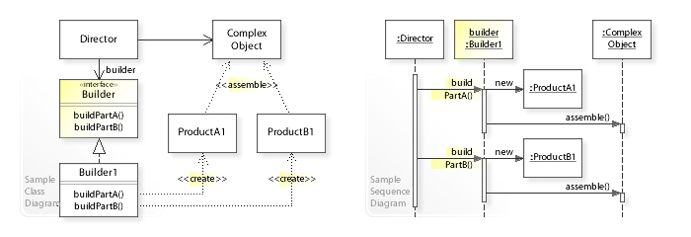
Builder
The intent of the Builder design pattern is to separate the construction of a complex object from its representation. By doing so the same construction process can create different representations

Slide 18
Builder
The Builder design pattern solves problems like:
How can a class (the same construction process) create different representations of a complex object?
How can a class that includes creating a complex object be simplified?
The Builder design pattern describes how to solve such problems:
Encapsulate creating and assembling the parts of a complex object in a separate Builder object.
A class delegates object creation to a Builder object instead of creating the objects directly.

Slide 19
Builder
Can you think out a scenario to use builder pattern in your previous coding task?

Slide 20
Prototype
The prototype pattern is a creational design pattern in software development. It is used when the type of objects to create is determined by a prototypical instance, which is cloned to produce new objects. This pattern is used to:
avoid subclasses of an object creator in the client application, like the factory method pattern does.
avoid the inherent cost of creating a new object in the standard way (e.g., using the 'new' keyword) when it is prohibitively expensive for a given application.

Slide 21
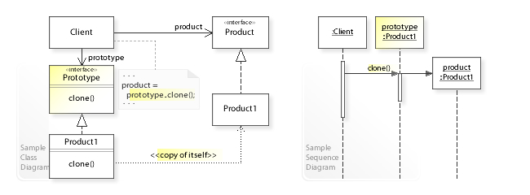
Prototype

Slide 22
Prototype
The Prototype design pattern solves problems like:
How can objects be created so that which objects to create can be specified at run-time?
How can dynamically loaded classes be instantiated?
The Prototype design pattern describes how to solve such problems:
Define a Prototype object that returns a copy of itself.
Create new objects by copying a Prototype object.

Slide 23
Prototype
Can you think out a scenario to use prototype pattern in your previous coding task?

Slide 24
Adaptor
Adapter pattern converts the interface of a class into another interface clients expect. Adapter lets classes work together that couldn't otherwise because of incompatible interfaces.
The pre-condiction is that do not change the existing interface/class, but leverage (inherit/composite) an existing object to implement a new interface.

Slide 25
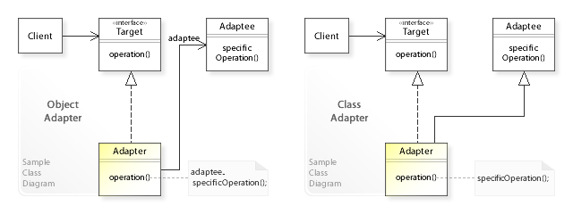
Adaptor

Slide 26
Adaptor
The Adapter design pattern solves problems like:
How can a class be reused that does not have an interface that a client requires?
How can classes that have incompatible interfaces work together?
How can an alternative interface be provided for a class?
The Adapter design pattern describes how to solve such problems:
Define a separate Adapter class that converts the (incompatible) interface of a class (Adaptee) into another interface (Target) clients require.
Work through an Adapter to work with (reuse) classes that do not have the required interface.

Slide 27
Adapter
Can you think out a scenario to use adapter pattern in your previous coding task?

Slide 28
Bridge
The bridge pattern is a design pattern used in software engineering that is meant to "decouple an abstraction from its implementation so that the two can vary independently", introduced by the Gang of Four. The bridge uses encapsulation, aggregation, and can use inheritance to separate responsibilities into different classes.

Slide 29
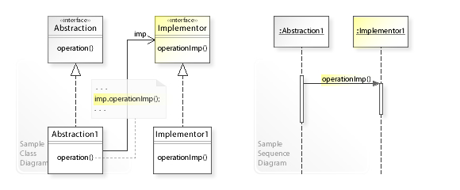
Bridge

Slide 30
Bridge
What problems can the Bridge design pattern solve?
An abstraction and its implementation should be defined and extended independently from each other.
A compile-time binding between an abstraction and its implementation should be avoided so that an implementation can be selected at run-time.
What solution does the Bridge design pattern describe?
Separate an abstraction (Abstraction) from its implementation (Implementor) by putting them in separate class hierarchies.
Implement the Abstraction in terms of (by delegating to) an Implementor object.

Slide 31
Bridge
Can you think out a scenario to use bridge pattern in your previous coding task?

Slide 32
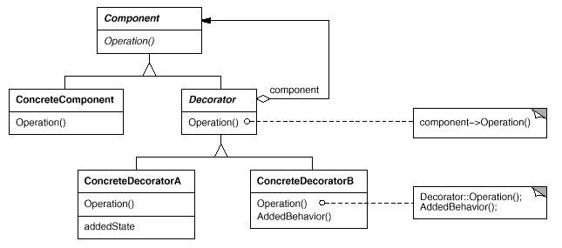
Decorator
Decorator attaches additional responsibilities to an object dynamically. Decorators provide a flexible alternative to subclassing for extending functionality.
The pre-condiction is that existing interface should not be changed, and it's required to supplement functions to existing implementations.

Slide 33
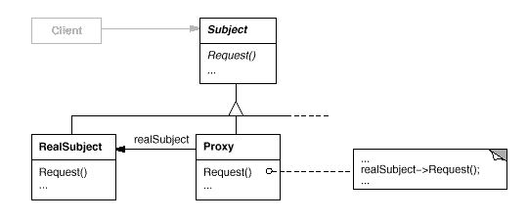
Proxy
Proxy pattern provides a surrogate or placeholder for another object to control access to it.

Slide 34
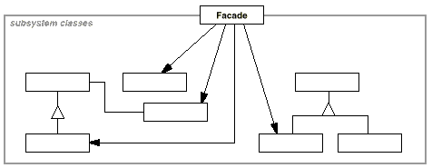
Facade
Provide a unified interface to a set of interfaces in a subsystem. Facade defines a higher-level interface that makes the subsystem easier to use.
The pre-condiction is that not changing the existing several intefaces, but build a new one and consolidate/simplify the interface to caller.

Slide 35
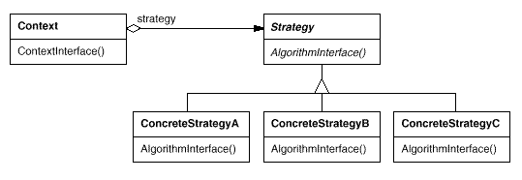
Strategy
Strategy define a family of algorithms, encapsulate each one, and make them interchangeable. Strategy lets the algorithm vary independently from clients that use it.

Slide 36
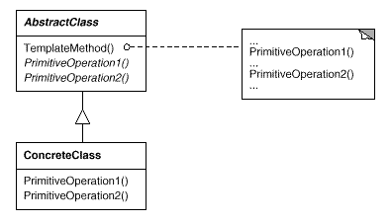
Template Method
Template Method Pattern defines the skeleton of an algorithm in an operation, deferring some steps to subclasses. Template Method lets subclasses redefine certain steps of an algorithm without changing the algorithm's structure.

